Slide 1

DATA INTERPRETATION

Slide 2
Data Interpretation
Introduction to DI and discussion on different types of Data
Average, Percentage, Approximation and Ratio concept introduction
Concepts of Bar Graphs & Line Graph
Concepts of Table Charts
Concepts of Pie Charts
Concept of Mixed Charts

Slide 3
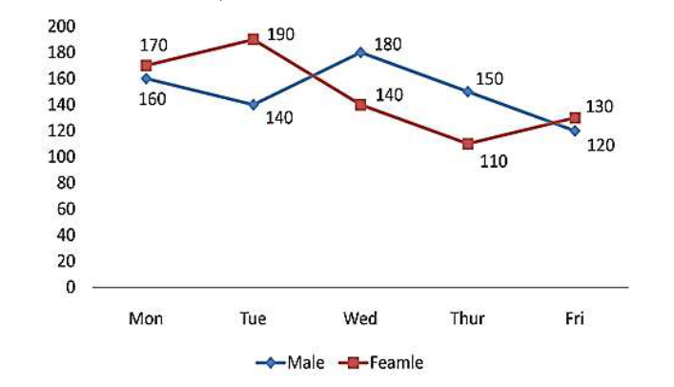
DATA INTERPRETATION
Directions (Q1 to 5): Study the following information carefully and answer the questions given beside:
Q1. Find the ratio of the total number of males visited the place on Tuesday and Thursday together to the total number of females visited the place on Monday and Friday together?
29: 30
30: 29
25: 26
26: 25
None of these
Number of male and number of females are given, they are visiting a place from Monday to Friday.
Notes:
Correct Answer: Option A
Level: Easy (Compulsory)

Slide 4
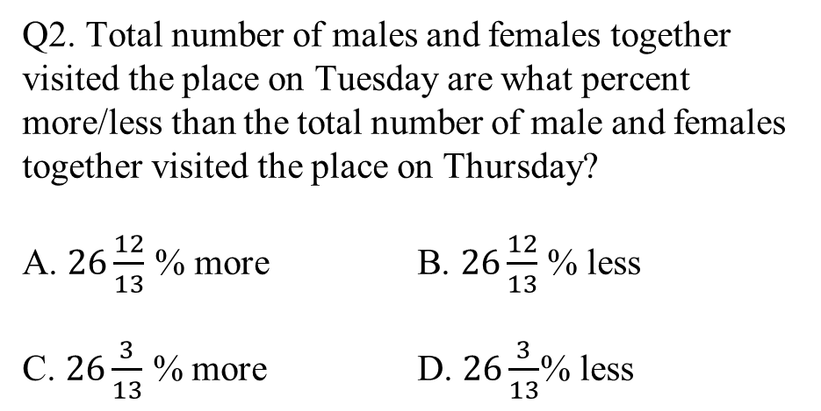
DATA INTERPRETATION
Directions (Q1 to 5): Study the following information carefully and answer the questions given beside:
Q2. Total number of males and females together visited the place on Tuesday are what percent more/less than the total number of male and females together visited the place on Thursday?
A. $26\frac{12}{13}$ % more B. $26\frac{12}{13}$ % less
C. $26\frac{3}{13}$ % more D. $26\frac{3}{13}$% less
Number of male and number of females are given, they are visiting a place from Monday to Friday.
Notes:
Correct Answer: Option A
Level: Easy (Compulsory)

Slide 5
DATA INTERPRETATION
Directions (Q1 to 5): Study the following information carefully and answer the questions given beside:
Q3. Find the difference between the total number of females visited the place from Monday to
Wednesday and the total number of males visited the place from Wednesday to Friday?
A. 30
B. 60
C. 40
D. 50
Number of male and number of females are given, they are visiting a place from Monday to Friday.
Notes:
Correct Answer: Option D
Level: Easy (Compulsory)

Slide 6
DATA INTERPRETATION
Directions (Q1 to 5): Study the following information carefully and answer the questions given beside:
Q4. If on Saturday number of males and number of females increased by 25% and 20% respectively
as compared to that on Friday then find the total number of males and females together visited
the place on Saturday?
A. 196
B. 306
C. 316
D. 206
Number of male and number of females are given, they are visiting a place from Monday to Friday.
Notes:
Correct Answer: Option B
Level: Easy (Compulsory)

Slide 7
DATA INTERPRETATION
Directions (Q1 to 5): Study the following information carefully and answer the questions given beside:
Q5. Total number of males and females visited the place on Monday and Tuesday together is how
much more than the total number of males and females visited the place on Thursday and
Friday together?
A. 175
B. 125
C. 150
D. 160
Number of male and number of females are given, they are visiting a place from Monday to Friday.
Notes:
Correct Answer: Option C
Level: Easy (Compulsory)

Slide 8
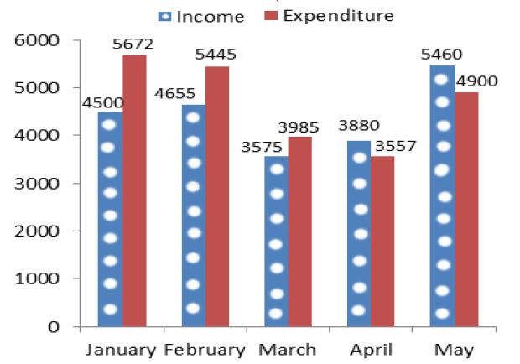
DATA INTERPRETATION
Directions: (Q 6- 10) : Study the following bar chart carefully and answer the questions given
The data given below shows the amount of salary received by Kartik and the total expenditure for Five months. If his salary falls short of the expenditure in any month, he borrows the required money to meet the expenditure from his friend Arun. If he saves some money in any month he gives that complete amount to Arun.
Q6. What is the total amount of money that Kartik owes his friend Arun at the end of the month of May?
A. Rs. 1529
B. Rs. 1489
C. Rs. 1389
D. Rs. 1469
Notes:
Correct Answer: Option B
Level: Moderate (Compulsory)

Slide 9
DATA INTERPRETATION
Directions: (Q 6- 10) : Study the following bar chart carefully and answer the questions given
The data given below shows the amount of salary received by Kartik and the total expenditure for Five months. If his salary falls short of the expenditure in any month, he borrows the required money to meet the expenditure from his friend Arun. If he saves some money in any month he gives that complete amount to Arun.
Q7. During these five months the total amount of money returned by Kartik to Arun is what percent of the total amount of money he borrowed from him?
A. 36.56%
B. 38.56%
C. 37.23%
D. 39.13%
Notes:
Correct Answer: Option C
Level: Moderate (Compulsory)

Slide 10
DATA INTERPRETATION
Directions: (Q 6- 10) : Study the following bar chart carefully and answer the questions given
The data given below shows the amount of salary received by Kartik and the total expenditure for Five months. If his salary falls short of the expenditure in any month, he borrows the required money to meet the expenditure from his friend Arun. If he saves some money in any month he gives that complete amount to Arun.
Q8. What is the average expenditure of Kartik from January to May?
A. Rs. 4788
B. Rs. 4789.6
C. Rs. 4667.8
D. Rs. 4711.8
Notes:
Correct Answer: Option D
Level Moderate (Compulsory)

Slide 11
DATA INTERPRETATION
Directions: (Q 6- 10) : Study the following bar chart carefully and answer the questions given
The data given below shows the amount of salary received by Kartik and the total expenditure for Five months. If his salary falls short of the expenditure in any month, he borrows the required money to meet the expenditure from his friend Arun. If he saves some money in any month he gives that complete amount to Arun.
Q9. In the month of June the expenditure of Kartik is Rs. 36489 and Kartik wants to clear the total amount he owes to Arun, then what was the salary of Kartik in the month of June if he saves Rs. 1200 after clearing the amount he owes to Arun?
A. Rs. 39168
B. Rs. 37189
C. Rs. 39178
D. Rs. 38179
Notes:
Correct Answer: Option C
Level: Moderate (Compulsory)

Slide 12
DATA INTERPRETATION
Directions: (Q 6- 10) : Study the following bar chart carefully and answer the questions given
The data given below shows the amount of salary received by Kartik and the total expenditure for Five months. If his salary falls short of the expenditure in any month, he borrows the required money to meet the expenditure from his friend Arun. If he saves some money in any month he gives that complete amount to Arun.
Q10. What is the difference between the total income of January, February and April and the total expenditure of February, March and May?
A. Rs. 1395
B. Rs. 1365
C. Rs. 1295
D. Rs. 1465
Notes:
Correct Answer: Option C
Level: Moderate (Compulsory)

Slide 13
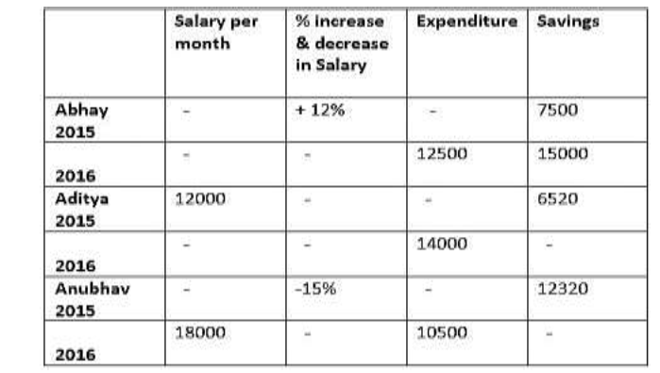
DATA INTERPRETATION
Directions (Q11 to 15): Study the following table carefully and answer the questions below.
Distribution of Salary of Abhay, Aditya and Anubhav over 2015 and 2016:
Q11. What was the approximate salary of Abhay in 2015 and Aditya in 2016 together if saving of Aditya in 2016 is 70% of that in 2015(in Rs.)?
A. 51286
B. 43118
C. 32811
D. 40290
Notes:
Correct Answer: Option B
Level: Moderate (Compulsory)

Slide 14
DATA INTERPRETATION
Directions (Q11 to 15): Study the following table carefully and answer the questions below.
Distribution of Salary of Abhay, Aditya and Anubhav over 2015 and 2016:
Q12. What was the percentage change in Abhay’s
expenditure from 2015 to 2016?
A. 16.5% decrease
B. 26.7% increase
C. 26.7% decrease
D. 16.6% decrease
Notes:
Correct Answer: Option C
Level: Moderate (Compulsory)

Slide 15
DATA INTERPRETATION
Directions (Q11 to 15): Study the following table carefully and answer the questions below.
Distribution of Salary of Abhay, Aditya and Anubhav over 2015 and 2016:
Q13. The percentage increase in the Aditya’s savings from 2015 to 2016 is 30%, then find the percentage increment in his salary from 2015 to 2016?
A. 68.5%
B. 49.9%
C. 87.3%
D. 92.7%
Notes:
Correct Answer: Option C
Level: Moderate (Compulsory)

Slide 16
DATA INTERPRETATION
Directions (Q11 to 15): Study the following table carefully and answer the questions below.
Distribution of Salary of Abhay, Aditya and Anubhav over 2015 and 2016:
Q14. What is the difference between the average salary of Abhay and Anubhav together in 2016 and the average salary of Aditya for two years. If saving of Aditya in 2015 is 25% more than in 2016?
A. 5600
B. 4928
C. 5400
D. None of these
Notes:
Correct Answer: Option D
Level: Moderate (Compulsory)

Slide 17
DATA INTERPRETATION
Directions (Q11 to 15): Study the following table carefully and answer the questions below.
Distribution of Salary of Abhay, Aditya and Anubhav over 2015 and 2016:
Q15. What is the total expenditure of Abhay, Aditya and Anubhav for two years?
A. 68930
B. 42829
C. 21990
D. 68390
Notes:
Correct Answer: Option D
Level: Moderate(Compulsory)

Slide 18
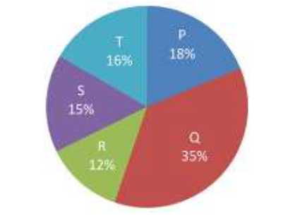
DATA INTERPRETATION
Directions (Q16 to 20): Study the following information carefully and answer the questions given beside:
The following chart shows the percentage purchase of 5 different people P, Q, R, S and T done for upcoming festivals.
Q16. What is the difference between the total purchase of items made by R and T together and the total purchase of items made by P and S together?
237
235
335
245
No. of total items purchased = 4700
Notes:
Correct Answer: Option B
Level: Easy (Compulsory)

Slide 19
DATA INTERPRETATION
Directions (Q16 to 20): Study the following information carefully and answer the questions given beside:
The following chart shows the percentage purchase of 5 different people P, Q, R, S and T done for upcoming festivals.
Q17. What is the ratio of the total purchase made by P, R and T together to that of S and Q together?
23: 25
25: 27
31: 33
13: 15
No. of total items purchased = 4700
Notes:
Correct Answer: Option A
Level: Easy (Compulsory)

Slide 20
DATA INTERPRETATION
Directions (Q16 to 20): Study the following information carefully and answer the questions given beside:
The following chart shows the percentage purchase of 5 different people P, Q, R, S and T done for upcoming festivals.
Q18. If Q pays Rs. 6300 for his total purchase then how much money P has to pay for his purchase?
A. Rs. 1240
B. Rs. 2260
C. Rs. 3644
D. Rs. 3240
No. of total items purchased = 4700
Notes:
Correct Answer: Option D
Level: Easy (Compulsory)

Slide 21
DATA INTERPRETATION
Directions (Q16 to 20): Study the following information carefully and answer the questions given beside:
The following chart shows the percentage purchase of 5 different people P, Q, R, S and T done for upcoming festivals.
Q19. Total purchase made by R is what percent less than the purchase made by S?
A. 10%
B. 15%
C. 20%
D. 25%
No. of total items purchased = 4700
Notes:
Correct Answer: Option C
Level: Easy (Compulsory)

Slide 22
DATA INTERPRETATION
Directions (Q16 to 20): Study the following information carefully and answer the questions given beside:
The following chart shows the percentage purchase of 5 different people P, Q, R, S and T done for upcoming festivals.
Q20. Find the central angle of the purchase made by S?
A. 45°
B. 54°
C. 67°
D. 50°
No. of total items purchased = 4700
Notes:
Correct Answer: Option B
Level: Easy (Compulsory)

Slide 23
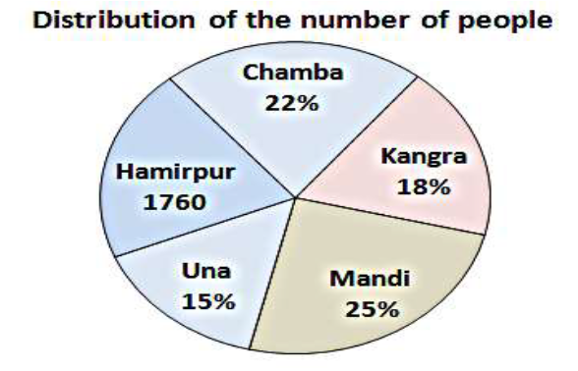
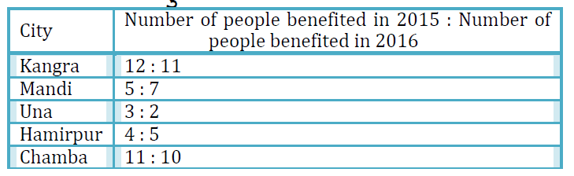
DATA INTERPRETATION
Directions: (Q 21-22) : Answer the questions based on the information given below.
Different number of people from five different towns is benefited by DBT (Direct benefit transfer) scheme launched by the central Government. The pie chart given below shows the distribution of the number of people benefited by DBT scheme in 2015 either in the form of percentage or absolute value.
Q21. Find the average number of people who were benefited by the DBT scheme in Kangra, Hamirpur and Chamba in 2015?
A. 1520
B. 1440
C. 1760
D. 1660
The table given below shows the ratio of the number of people who were benefited by the DBT scheme in 2015 to that in 2016.
Notes:
Correct Answer: Option C
Level: Expert (Compulsory)

Slide 24
DATA INTERPRETATION
Directions: (Q 21-22) : Answer the questions based on the information given below.
Different number of people from five different towns is benefited by DBT (Direct benefit transfer) scheme launched by the central Government. The pie chart given below shows the distribution of the number of people benefited by DBT scheme in 2015 either in the form of percentage or absolute value.
Q22. Number of people who were benefited by DBT scheme from Una in 2015 is what percentage less/more than the number of people who were benefited by the DBT scheme from Chamba in 2016?
A. 20%
B. 25%
C. 33.33%
D. 40%
The table given below shows the ratio of the number of people who were benefited by the DBT scheme in 2015 to that in 2016.
Notes:
Correct Answer: Option B
Level: Expert (Compulsory)

Slide 25
DATA INTERPRETATION
Directions: (Q.23-25) : Study the following bar chart and pie chart carefully and answer the questions given beside.
Q23. What is the approximate percentage of students who did not appear for the Science Olympiad exam from School A of the total students who did not appear for the exam from all the schools if the total percentage of the students who did not appear for the exam is 25% of the total students who appeared for the exam?
A. 7%
B. 8%
C. 9%
D. 10%
The following bar graph provides the information about the total number of Students from 5 different schools.
The following pie chart provides the information about the percentage of students who appeared for the Science Olympiad exam out of the total students of 5 different schools mentioned above.
Notes:
Correct Answer: Option A
Level: Expert (Compulsory)

Slide 26
DATA INTERPRETATION
Directions: (Q.23-24) : Study the following bar chart and pie chart carefully and answer the questions given beside.
Q24. If the number of students who appeared for the Science Olympiad exam from school A and B together is 60 % of the total students from these schools, find the ratio of the students who did not appear for the exam from school E to that of the students who appeared for the exam from
A and B together?
A. 5: 19
B. 9: 16
C. 8: 17
D. 7: 18
The following bar graph provides the information about the total number of Students from 5 different schools.
The following pie chart provides the information about the percentage of students who appeared for the Science Olympiad exam out of the total students of 5 different schools mentioned above.
Notes:
Correct Answer: Option D
Level: Expert (Compulsory)

Slide 27
Any Doubts???

